Slide 1
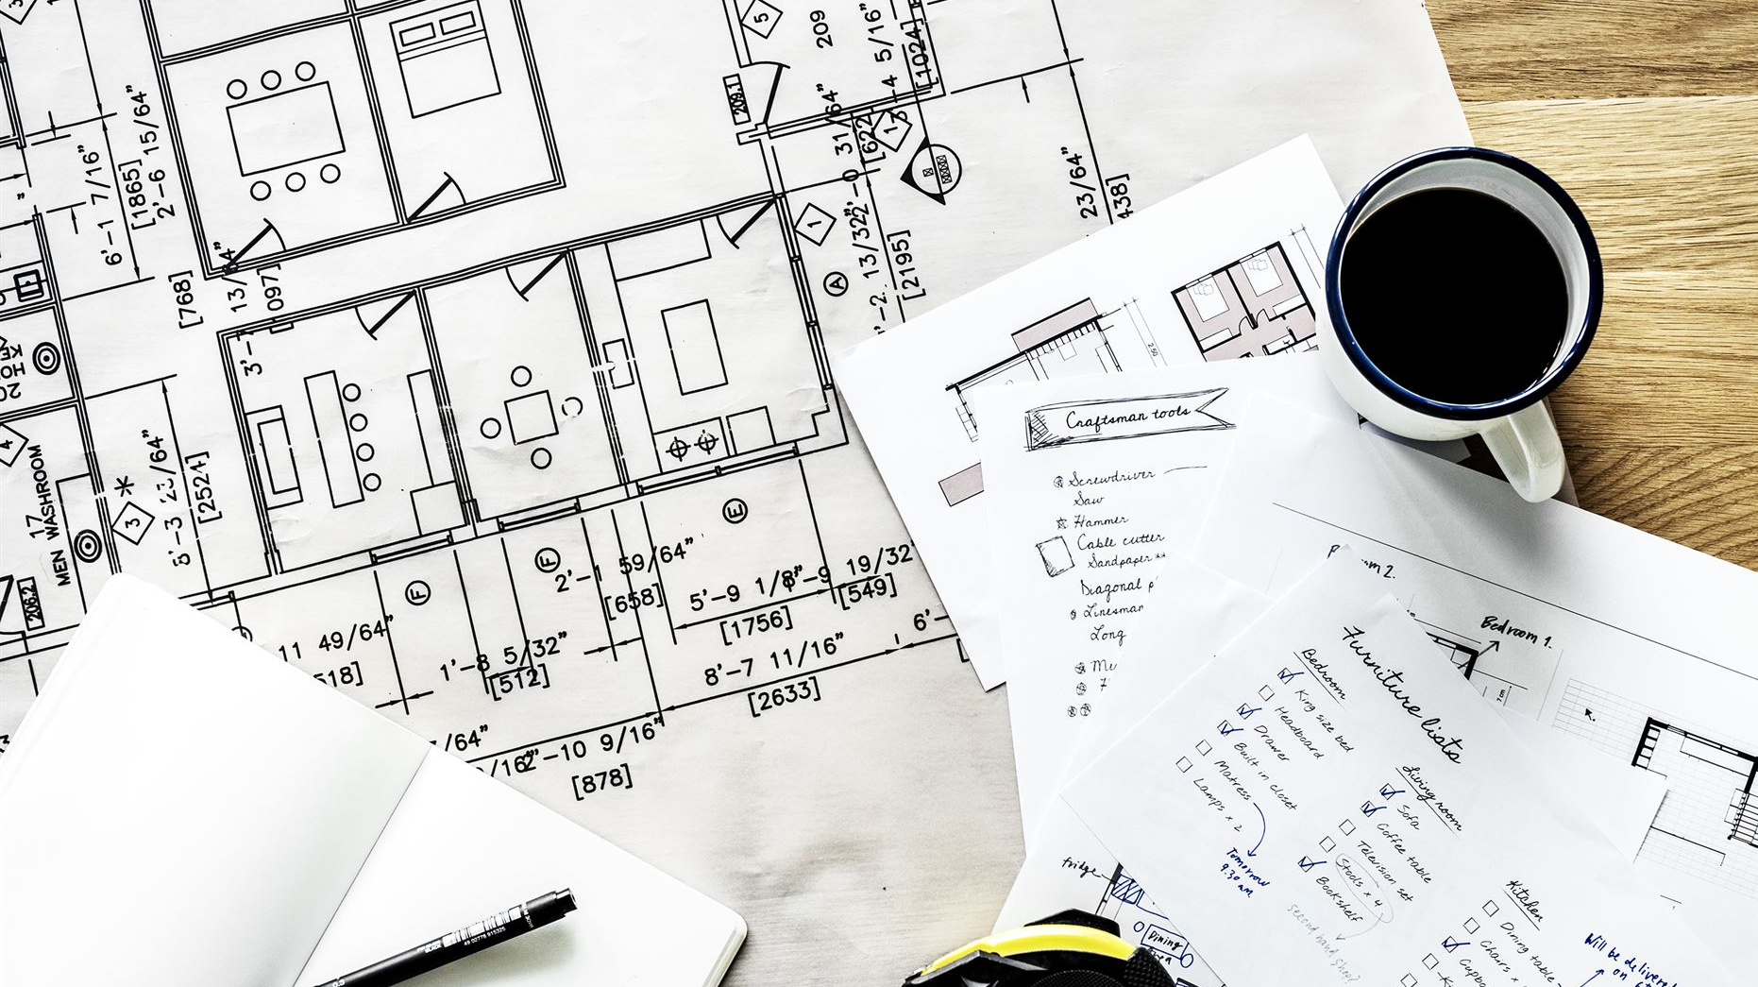
Comparing Agile and Waterfall Development Approaches
Understanding the strengths and weaknesses of each method
Notes:
AI-generated content may be incorrect. --- In this presentation, we will explore two predominant development methodologies: Agile and Waterfall. We'll analyze their roles, phases, and key differences to help understand when to use each approach effectively. Image source: Microsoft 365 content library

Slide 2
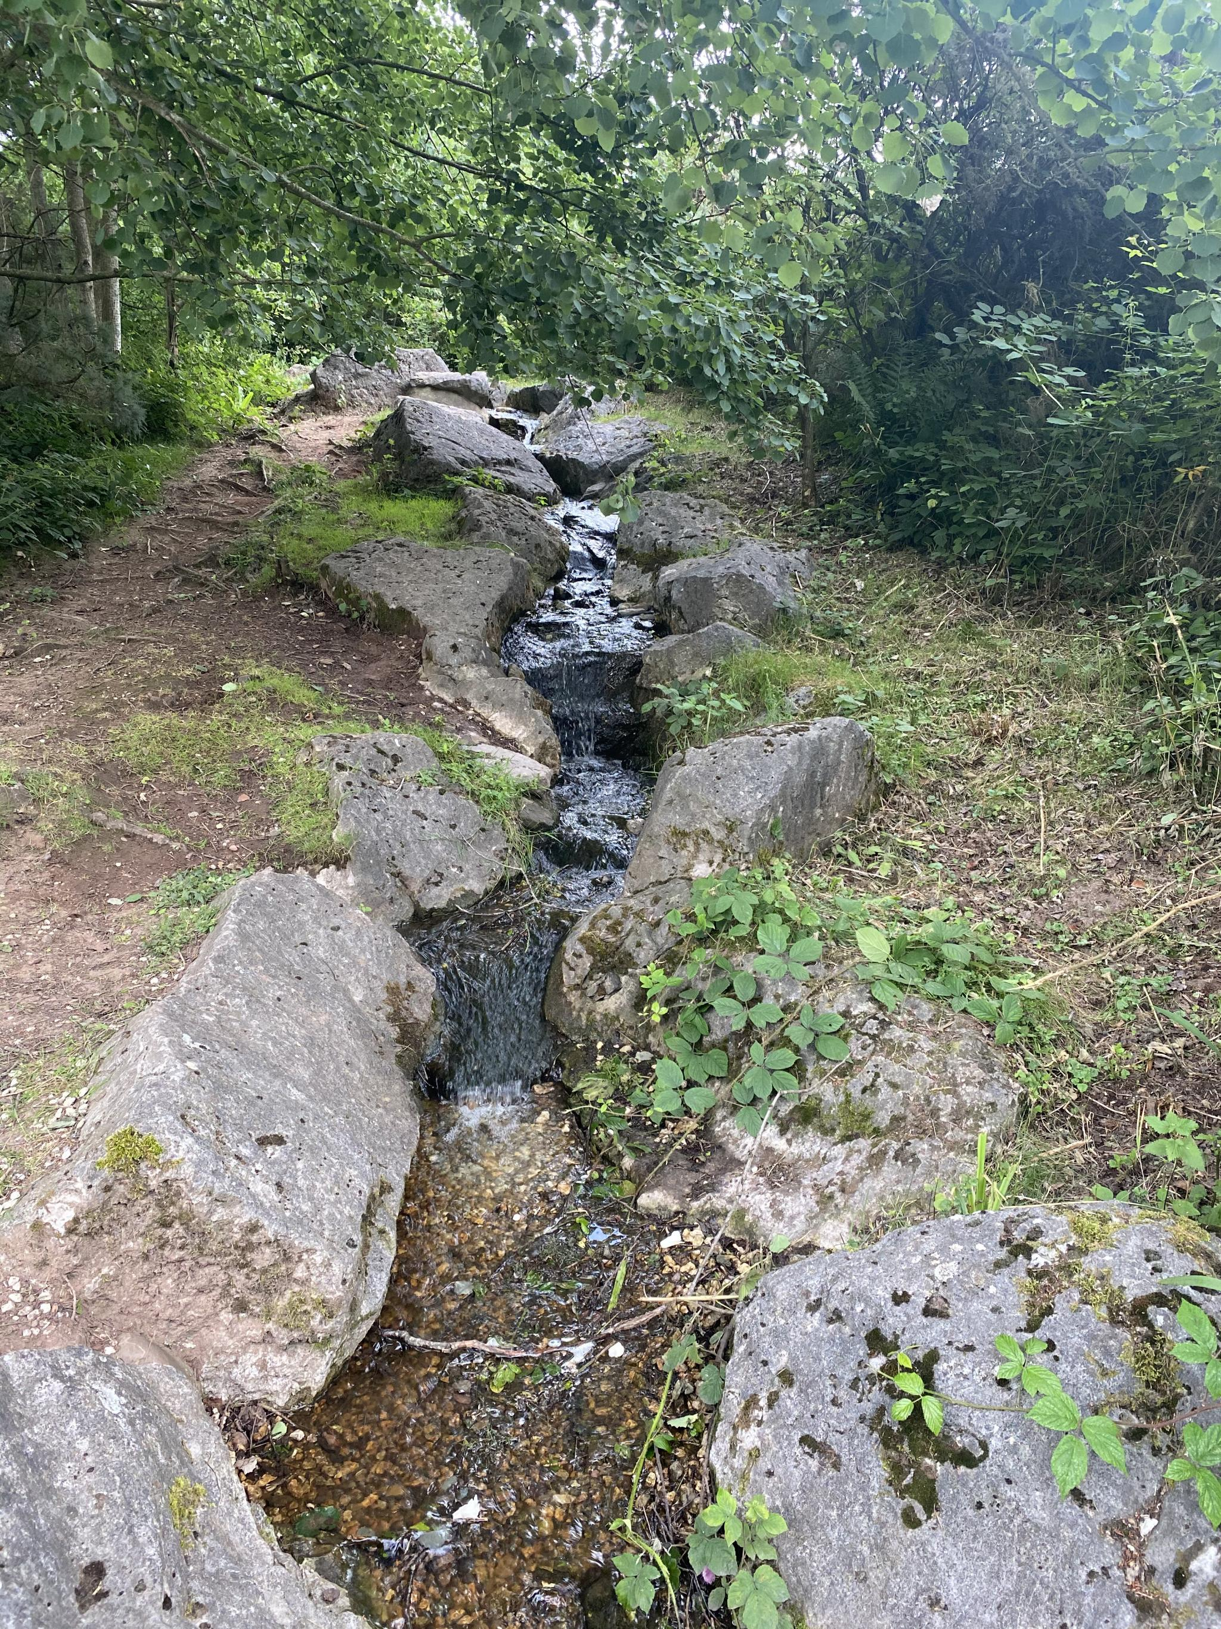
Agenda Items
Explaining Agile Roles
Explaining Agile Phases
Describing Waterfall Model
Waterfall or Agile Approach
Notes:
--- We will begin by discussing the roles within Agile methodology, followed by an exploration of Agile phases. Then, we will describe the Waterfall model in detail, including its phases and challenges. Finally, we will compare and contrast the two approaches to determine the best fit for various projects. Image source: Microsoft 365 content library

Slide 3
Explaining Agile Roles
Notes:
Understanding the roles within Agile is crucial for the methodology's success. Each role plays a unique part in ensuring that the project aligns with its goals and objectives.

Slide 4
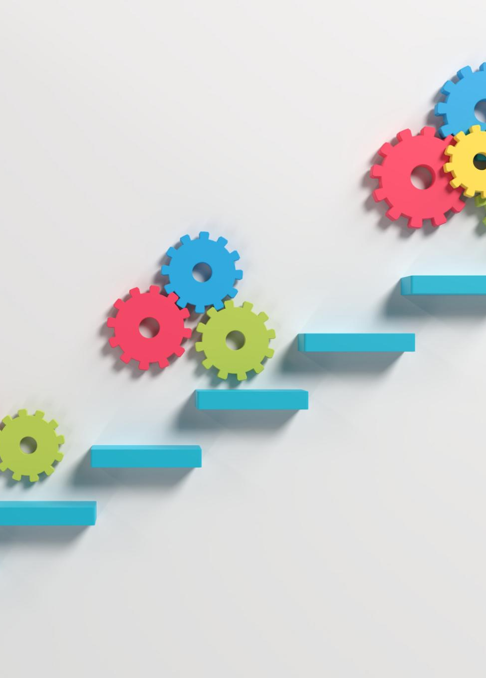
Product Owner: Vision and Priorities Management
Defining Product Vision
The Product Owner plays a crucial role in defining the product vision, aligning it with business goals and stakeholder expectations (Chervenkova, 2024).
Managing Backlog Priorities
Effective backlog management is essential for the Product Owner to prioritize features that deliver the most value to users and stakeholders(Chervenkova, 2024).
Liaison Between Teams
The Product Owner bridges the gap between stakeholders and the development team, facilitating communication and ensuring alignment on priorities (Chervenkova, 2024).
Notes:
--- The Product Owner is responsible for defining the vision for the product and managing the priorities of the backlog. They serve as the primary liaison between stakeholders and the development team, ensuring that the most valuable features are delivered first. Image source: Microsoft 365 content library

Slide 5

Scrum Master: Facilitator and Process Guardian
Facilitator Role
The Scrum Master facilitates Agile ceremonies and ensures that the team collaborates effectively throughout the development process (Chervenkova, 2024).
Resolving Impediments
An essential responsibility of the Scrum Master is to identify and resolve impediments that hinder the team's progress (Chervenkova, 2024).
Coaching Team Members
The Scrum Master plays a key role in coaching team members on Agile principles and fostering a culture of continuous improvement (Chervenkova, 2024).
Effective Communication
Maintaining clear and effective communication within the team and with stakeholders is a vital function of the Scrum Master (Chervenkova, 2024).
Notes:
--- The Scrum Master acts as a facilitator for the Agile team, ensuring that the process adheres to Agile principles. They help resolve impediments, coach team members, and maintain effective communication within the team and with stakeholders. Image source: Microsoft 365 content library

Slide 6

Development Team: Delivering Incremental Value
Collaborative Work
The Development Team works together to ensure the delivery of valuable product increments through collaboration and communication (Chervenkova, 2024).
Estimating Effort
Team members are responsible for estimating the effort required for various tasks, ensuring efficient project management (Chervenkova, 2024).
Continuous Improvement
The Development Team focuses on continuously improving their practices and processes to enhance product quality and efficiency (Chervenkova, 2024). A key attributor to this is the role of tester which ensures the product works both before and after release.
Notes:
--- The Development Team consists of professionals who work collaboratively to deliver high-quality increments of the product. They are responsible for estimating effort, organizing work, and continuously improving their practices. Image source: Microsoft 365 content library

Slide 7
Explaining Agile Phases
Notes:
Agile projects are structured around iterations, allowing teams to adapt and respond to changes rapidly. Each phase plays a critical role in the overall success of the development process.

Slide 8

Planning: Setting Goals and Defining Scope
Clear Goals
Setting clear goals is crucial for guiding the project and aligning team efforts towards a common objective (Zhezherau, 2025).
Defining Scope
Defining the scope of the project helps to outline the boundaries and deliverables, ensuring clarity for all stakeholders (Zhezherau, 2025).
Stakeholder Alignment
Ensuring all stakeholders have a shared understanding promotes collaboration and minimizes misunderstandings during the project (Zhezherau, 2025).
Notes:
--- During the planning phase, teams set clear goals and define the scope of the project. This ensures all stakeholders have a shared understanding of what to expect and what the priorities are. Image source: Microsoft 365 content library

Slide 9

Execution: Developing and Testing Increments
Iterative Development
The execution phase focuses on iterative development, where product increments are created in short cycles for quick feedback (Zhezherau, 2025).
Rapid Feedback
Short cycles in development allow teams to gather rapid feedback, enabling timely adjustments to the product (Zhezherau, 2025).
User-Centric Focus
This process ensures that the final product aligns with user needs, leading to higher satisfaction and usability (Zhezherau, 2025).
Notes:
--- In the execution phase, the team develops and tests product increments in short cycles, allowing for rapid feedback and adjustments. This iterative process helps ensure that the final product meets user needs. Image source: Microsoft 365 content library

Slide 10

Review and Retrospective: Continuous Improvement
Reflection on Work
The review phase enables teams to reflect on their achievements and challenges, fostering a deeper understanding of their performance (Zhezherau, 2025).
Gathering Feedback
Collecting feedback from team members and stakeholders is crucial for identifying strengths and weaknesses in the project (Zhezherau, 2025).
Identifying Areas for Improvement
The retrospective phase focuses on identifying actionable steps that teams can take to enhance their processes and output (Zhezherau, 2025).
Notes:
--- The review and retrospective phases allow teams to reflect on their work, gather feedback, and identify areas for improvement. This culture of continuous enhancement is fundamental to Agile success. Image source: Microsoft 365 content library

Slide 11
Describing Waterfall Model
Notes:
The Waterfall model is a traditional project management approach that follows a linear, sequential process. Understanding its structure is essential for evaluating its effectiveness versus Agile.

Slide 12
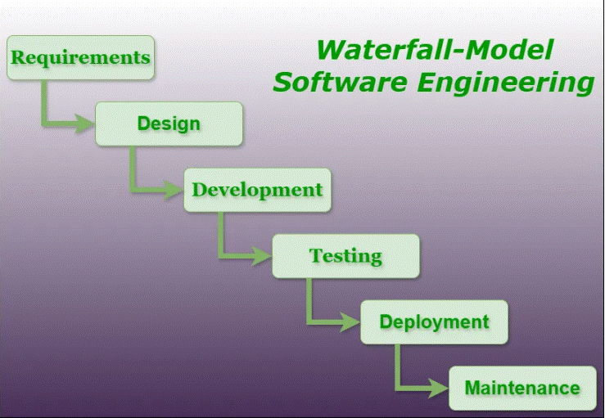
Linear Sequential Phases: Planning, Design, Implementation, Testing, Deployment
Planning Phase
In the planning phase, project objectives and requirements are defined, laying the foundation for the entire project (GeeksforGeeks, 2025).
Design Phase
The design phase involves creating architectural and technical specifications based on the requirements gathered during planning (GeeksforGeeks, 2025).
Implementation Phase
During implementation, the actual coding and development of the software take place according to design specifications (GeeksforGeeks, 2025).
Testing Phase
The testing phase ensures that the software is thoroughly evaluated for defects and meets the defined requirements (GeeksforGeeks, 2025).
Deployment Phase
In the deployment phase, the completed software is released and made available for end-users, completing the cycle (GeeksforGeeks, 2025).
Notes:
The Waterfall model consists of distinct phases that must be completed in order. Each phase, from planning to deployment, must be fully finished before moving on to the next, which can create challenges if changes are needed.

Slide 13
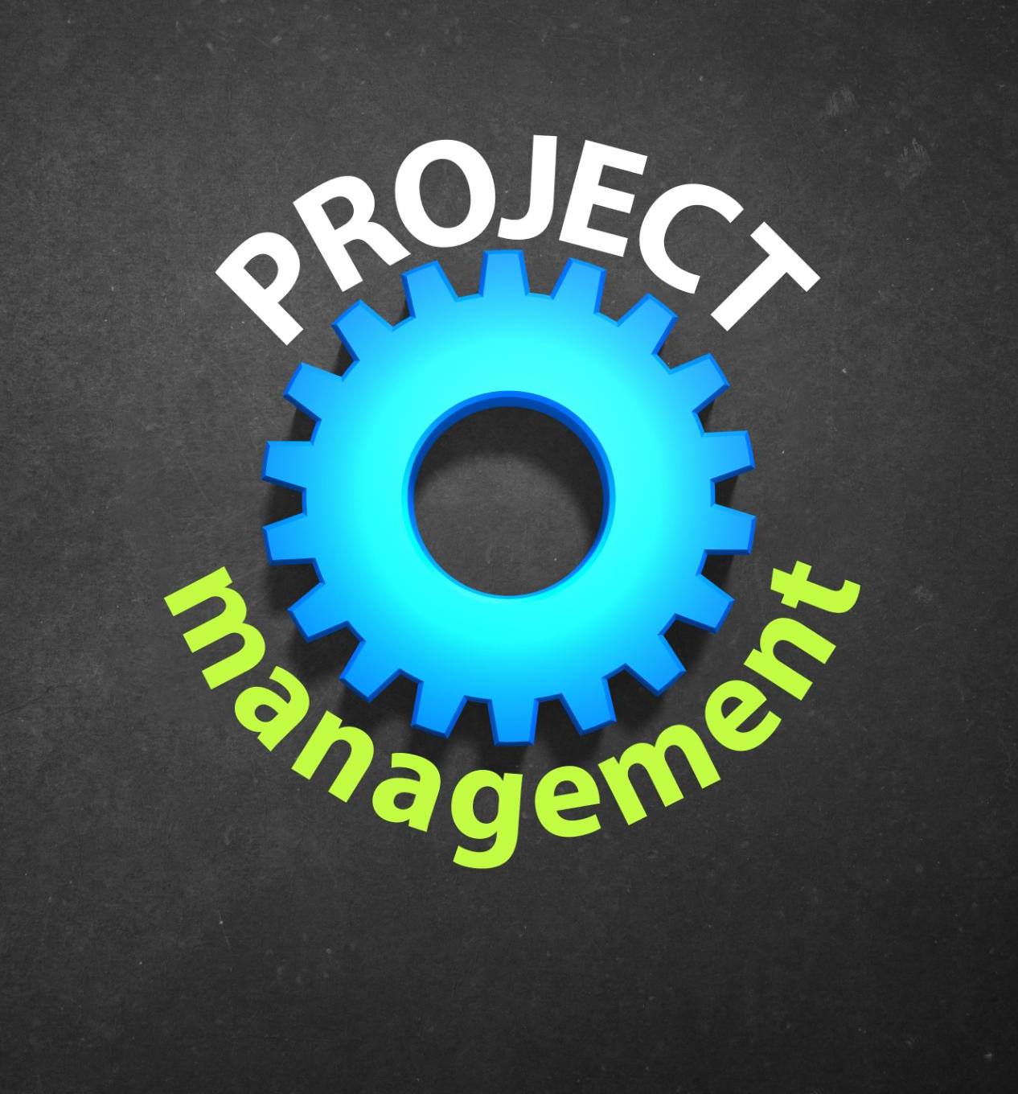
Handling Changes: Rigidity and Late-Stage Adaptations
Rigidity of Waterfall Approach
The Waterfall approach is characterized by its inflexible structure, making it challenging to adapt to changes (GeeksforGeeks, 2025).
Challenges of Late-Stage Changes
Once the project advances, late-stage changes can lead to significant delays and increased costs (GeeksforGeeks, 2025).
Cost Implications
Inflexibility in handling changes often escalates project costs and resource allocation (GeeksforGeeks, 2025).
Notes:
--- One of the main drawbacks of the Waterfall approach is its rigidity. Changes in requirements are often difficult to accommodate once the project progresses past the planning phase, leading to delays and increased costs. Image source: Microsoft 365 content library

Slide 14

Development Challenges: Example Problem Analysis
Understanding Requirements
Misunderstanding requirements at the beginning can cause delays and complications in the development process (GeeksforGeeks, 2025).
Rework Consequences
Significant rework later in the process results in wasted resources and extended project timelines (GeeksforGeeks, 2025).
Analyzing Typical Problems
Analyzing common issues in the Waterfall model helps teams understand their impacts and find solutions (GeeksforGeeks, 2025).
Notes:
--- Challenges in the Waterfall model can arise from misunderstanding requirements early on, which can lead to significant rework later. Analyzing a typical problem can help highlight these issues and their impacts. Image source: Microsoft 365 content library

Slide 15
How the SNHU Travel Project Would Change
In the beginning:
The project was well defined and could have followed a waterfall structure.
Make a travel website
Based on user interest
With a budget tool
User accounts that can save essential information
Filters vacations based off the budget and interests determined by the user.
In the end:
The customers decided that they wanted to add a detox and wellness filtering system due to recent research on new trends. This ‘trending’ feature was not discussed in the initial planning and would have had to wait until the end or be implemented as an entirely new project after release. The waterfall method would not have accommodated this change.

Slide 16
How the Issue would have been Handled:
It would have required a new negotiation and contract between the company and customer. This would have created an entirely new water fall based project just for this addition.
Or, it would have been added mid development and cost the customers a lot more money, and the development team would have to work overtime to readjust their workload and project scope.

Slide 17
Waterfall or Agile Approach
Notes:
Choosing between Agile and Waterfall requires careful consideration of project specifics. Factors such as project size, complexity, and stakeholder needs play a crucial role in determining the most suitable approach.

Slide 18

Project Size and Complexity: When to Use Each
Waterfall Methodology
Waterfall is a structured approach best suited for large, complex projects with clear requirements and deliverables (Radigan 2025).
Agile Methodology
Agile is a flexible and adaptive approach ideal for smaller, dynamic projects that require quick iterations and responsiveness (Radigan 2025).
Project Size Considerations
Choosing between Waterfall and Agile depends on project size, complexity, and the need for adaptability (Radigan 2025).
Notes:
--- Larger, more complex projects may benefit from the structured nature of Waterfall, while smaller, dynamic projects often thrive under Agile due to its flexibility and responsiveness. Image source: Microsoft 365 content library

Slide 19

Flexibility and Adaptability: Agile Benefits
Quick Response to Change
Agile methodologies allow teams to rapidly adapt to user feedback and changing market conditions, ensuring timely project adjustments (Radigan 2025).
Evolving Requirements
Agile is suitable for projects with evolving requirements, enabling teams to pivot and adjust their strategies, as necessary (Radigan 2025).
Enhanced Collaboration
Agile promotes enhanced collaboration among team members, fostering an environment where communication leads to better outcomes (Radigan 2025).
Notes:
--- Agile's strengths lie in its flexibility and adaptability. Teams can quickly respond to changes in user feedback or market demands, making it an excellent choice for environments where requirements are likely to evolve. Image source: Microsoft 365 content library

Slide 20

Stakeholder Involvement and Feedback: Choosing the Right Approach
Importance of Stakeholder Engagement
Stakeholder engagement is crucial for project success, influencing direction and outcomes throughout the development process (Radigan 2025).
Agile Methodology
Agile promotes continuous feedback, allowing stakeholders to be actively involved and adapt to changes during the project lifecycle (Radigan 2025).
Waterfall Approach
The Waterfall model typically offers less direct input from stakeholders throughout the project, affecting key decision-making moments (Radigan 2025).
Notes:
--- Stakeholder engagement is critical in project development. Agile promotes continuous feedback and involvement, while Waterfall may offer less direct input throughout the process, which impacts decision-making. Image source: Microsoft 365 content library

Slide 21
Course Experience
SNHU Travel Project
The project was to create a travel website that would expand their customer base by getting into trendy, niche vacation packages.
What this tells me
Since they want to follow trends, that means the nature of this website will be changing as time goes on, in fact, it’s a feature of the industry we are designing for. So, they need a mechanism to handle trends, user interests and the evolving market of vacation travel.
Why agile?
Since the team is developing for a fast paced, expanding market, it makes sense to use an agile framework to accommodate for this. We should expect the customer to come back to us mid-development with a new implementation. Since it is expected, it does not upheave the entire project and we can implement it as the rest of the development takes place.
Notes:
--- Stakeholder engagement is critical in project development. Agile promotes continuous feedback and involvement, while Waterfall may offer less direct input throughout the process, which impacts decision-making. Image source: Microsoft 365 content library

Slide 22
Conclusion
Agile Methodology
Agile is adaptive and promotes flexibility, allowing teams to respond quickly to changes and customer feedback throughout the project.
Waterfall Methodology
Waterfall is a linear approach that emphasizes thorough planning and documentation, making it suitable for projects with well-defined requirements.
Choosing the Right Approach
Understanding the strengths and challenges of both methodologies helps teams select the best approach, ensuring project success tailored to their needs.
Notes:
Both Agile and Waterfall have their unique strengths and challenges. Understanding these methodologies allows teams to choose the best approach for their projects, leading to successful outcomes tailored to specific needs.

Slide 23
References
Chervenkova, M. (2024, June 13). Agile team roles and responsibilities: A complete guide. Kanban Software for Agile Project Management. https://businessmap.io/blog/agile-team-roles
Zhezherau, A. (2025). The Agile software development life cycle | Wrike Agile guide. Versatile & Robust Project Management Software | Wrike. https://www.wrike.com/agile-guide/agile-development-life-cycle/
GeeksforGeeks. (2025, April 26). Waterfall model - Software engineering. GeeksforGeeks. https://www.geeksforgeeks.org/software-engineering/waterfall-model/
Radigan, D. (2025). Agile vs. waterfall project management. Atlassian. https://www.atlassian.com/agile/project-management/project-management-intro
Notes:
Both Agile and Waterfall have their unique strengths and challenges. Understanding these methodologies allows teams to choose the best approach for their projects, leading to successful outcomes tailored to specific needs.

